Slide 1
Data Cleaning for Textual Documents using NLP
By: Alanoud AlHwaireny
Lubna AlMoammar
Raghad AlKhudair
Shahad AlAmeel

Slide 2
Introduction
Data cleaning for large-scale datasets can be a daunting task. Automating the process of removing unneeded records is a very important problem in data science. So, we will develop a system that is able to help a data scientist organize his data based on the type of utterance using the annotated dataset provided.

Slide 3
About Dataset
The dataset is tweets taken from the replies @Tawakkalna_care Twitter account its about 2k data point (labeled) and it's classified with the type of utterance to:
Comment.
Question.
Answer.
Noise.
Repeated.
Notes:
Noise in this context refers to bot-generated advertisements in social media that do not contribute to the discussion or any other random text that is irrelevant

Slide 4
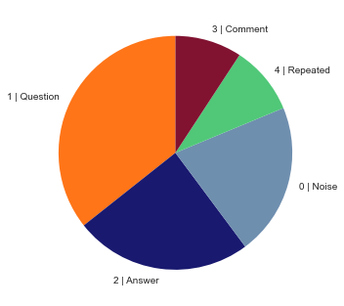
Exploratory Data Analysis
Observation: we notice in the graph that the questions most common tweet type then answers.

Slide 5


Data Cleaning
We removed :
Non- Arabic words.
Arabic stop words from text.
Numbers.
Emojis and replace it with “"ايموجي
Latin and special character: $#@

Slide 6



Preprocessing
1
2
Separate a sentence into list of words.
Create function counts number of emojis in a text.
3
4
Convert emoji to text.
Removes any non-arabic letters from text.
Notes:
1- In step one we used TFIDF to separate the sentences into weighted words.

Slide 7
Pre-work
To get better results, the team pulled more data. We got about 2,300 extra tweets from the @Tawakkalna_care account by Twitter API.

Slide 8

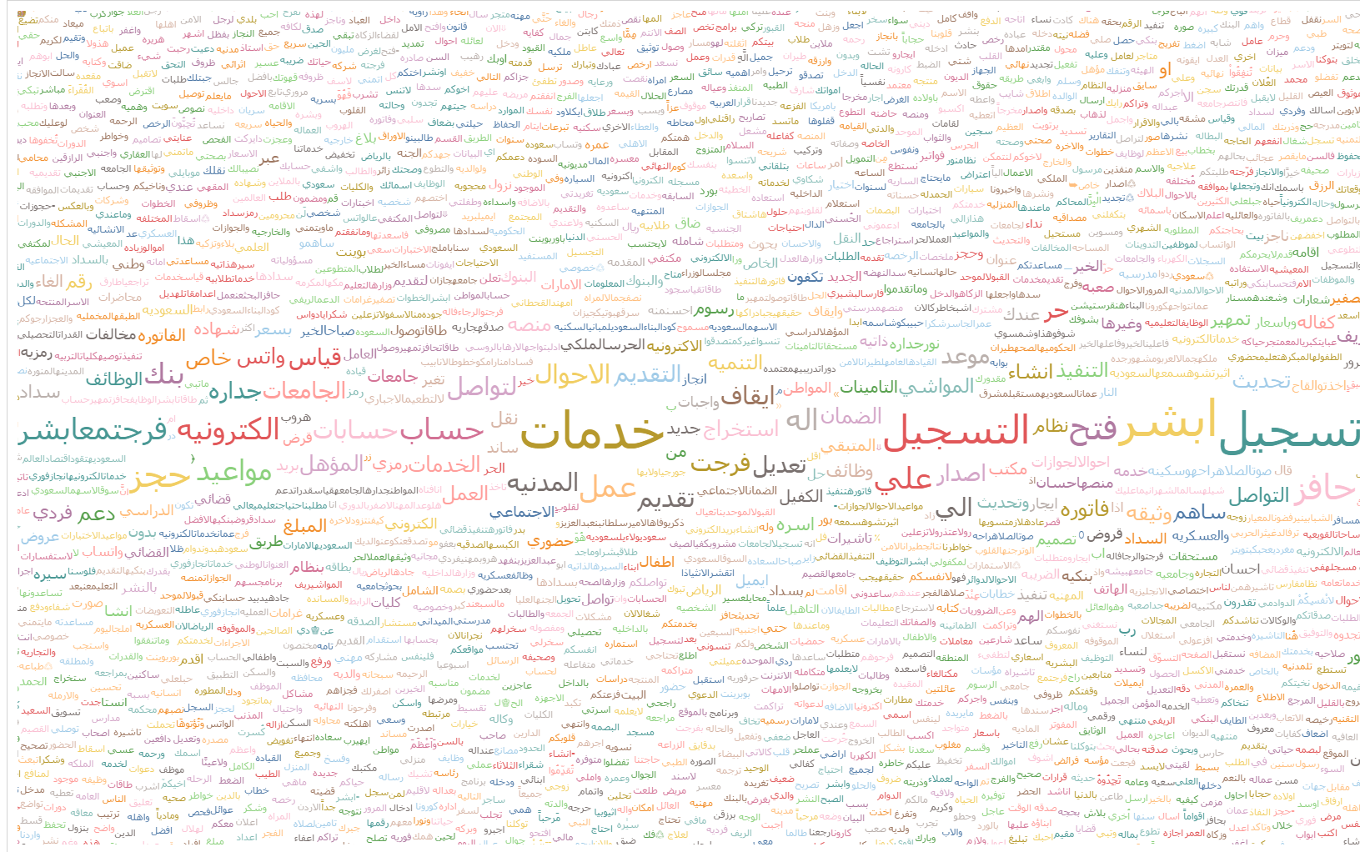
Visualization
The Cloud words for Noise tweets

Slide 9
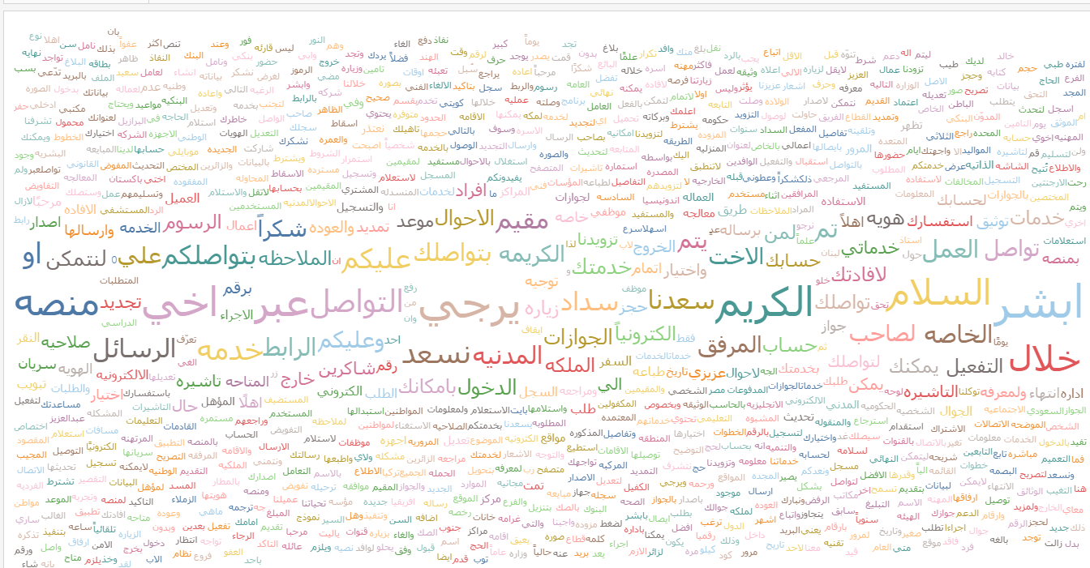
Visualization
The Cloud words for Answers tweets

Slide 10
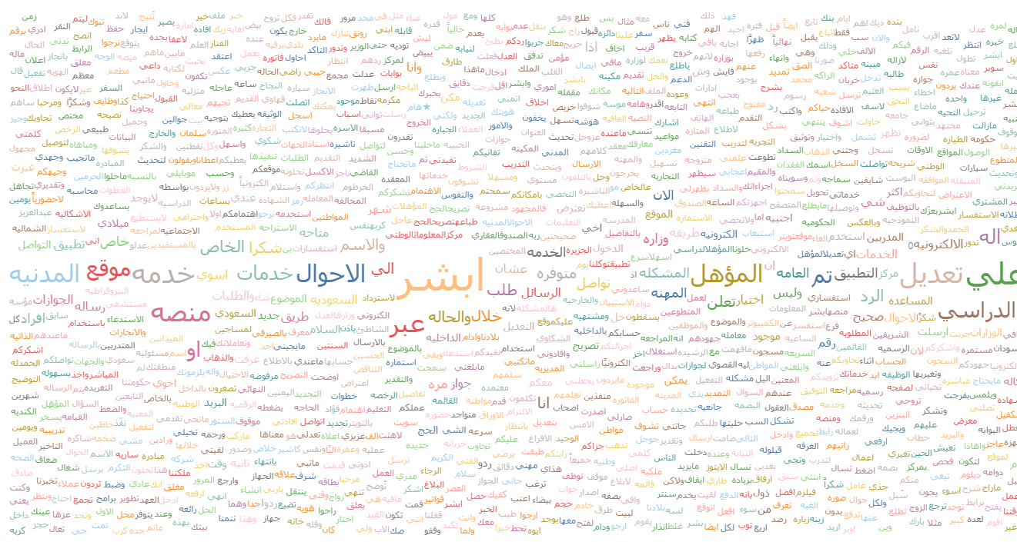
Visualization
The Cloud words for Comments tweets

Slide 11




Modelling
Baseline model using linear regression
Naïve Bayes
Random Forest
XGboost
Neural Networks
F1 Score
0.85
0.821
0.809
0.834
0.849
Neural Network has the highest score, which won the best classifier model!
Precision
0.833
0.834
0.860
0.86
0.824
Recall
0.837
0.837
0.835
0.842
0.86

Slide 12
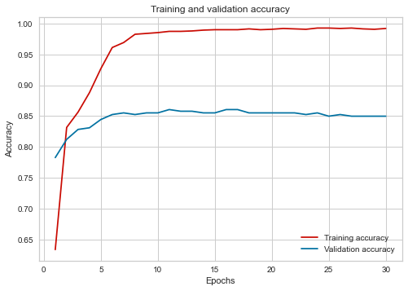
Neural Network Model
Model Summary
We use two Layers.
Activation function for the first layer was Relu.
Activation function for the second layer was Sigmoid.
Early stopping function.
Validation performance has achieved the highest score.
Neural network Model’s training and validation rate

Slide 13
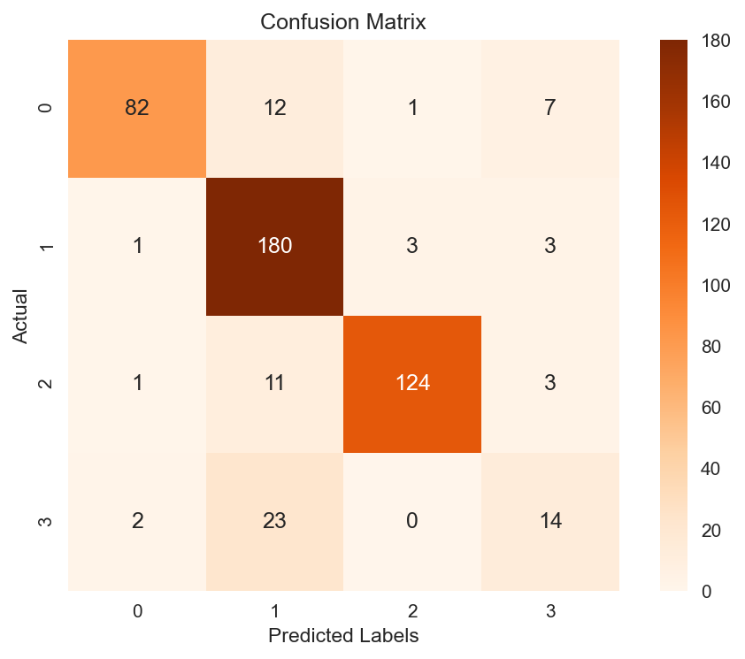

Neural Network Model
Here is the confusion matrix for Neural network model to visualize important predictive analytics like recall, specificity, accuracy, and precision.

